Slide 1
Mark Adams Innovation Hub Coordinator | ASIC
Tony Richards
Head of Payments Policy | RBA
Melisande Waterford
General Manager, Licensing | APRA
Tony Prior
Director, Compliance (Sydney)| AUSTRAC
Brett Watson Assistant Director, Regulation and Strategy| OAIC

Slide 2
Tonight…
5 x short presentations:
ASIC - Informal assistance, sandbox, international network and regtech
RBA – New payments platform update
APRA - Proposals for a phased approach to licensing banks
AUSTRAC - Public-private partnerships to combat financial crime
OAIC - Why privacy is important for new fintech businesses, and some tips on good data handling practices and conducting privacy impact assessments.
Q&A panel

Slide 3
The latest from the Innovation Hub Mark Adams | Innovation Hub Coordinator | ASIC 17 August 2017

Slide 4
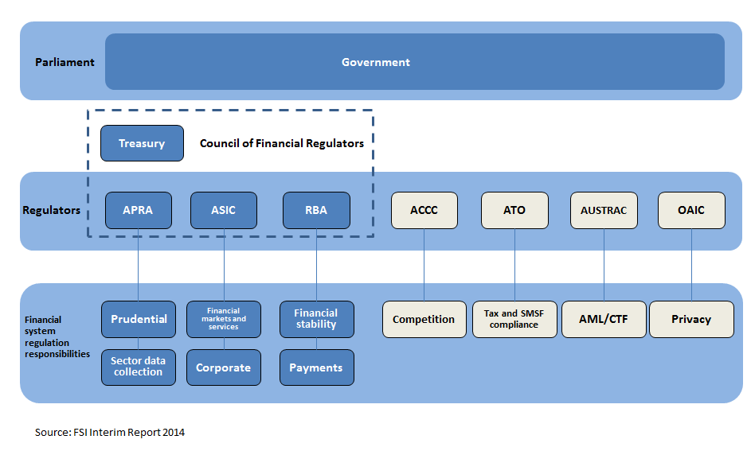
Australia’s financial regulatory framework

Slide 5
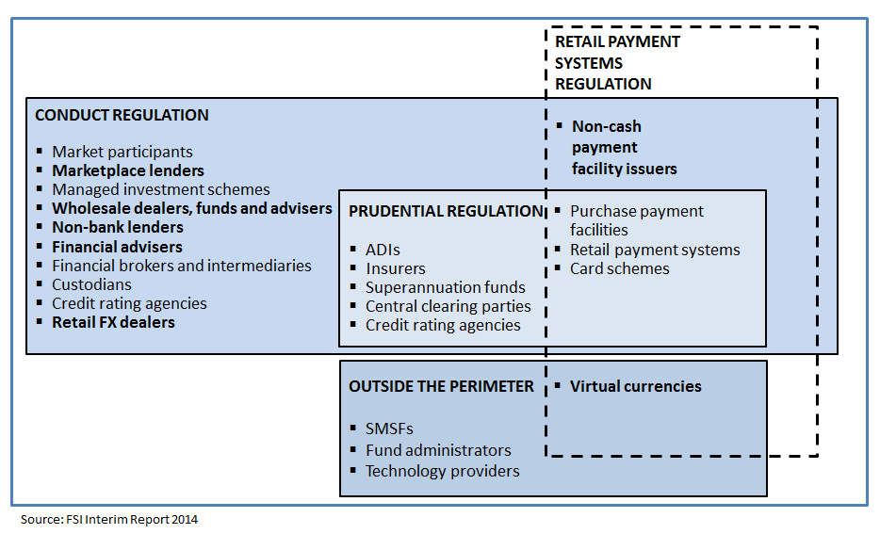
Current financial regulatory perimeters

Slide 6
ASIC’s approach to regulating fintech
Our challenge is finding the balance between:
Encouraging fintech and innovation, and
Not compromising on our core goals of promoting investor and consumer trust and confidence; and ensuring markets operate in a fair, orderly and transparent way.
How ASIC provides assistance

Slide 7
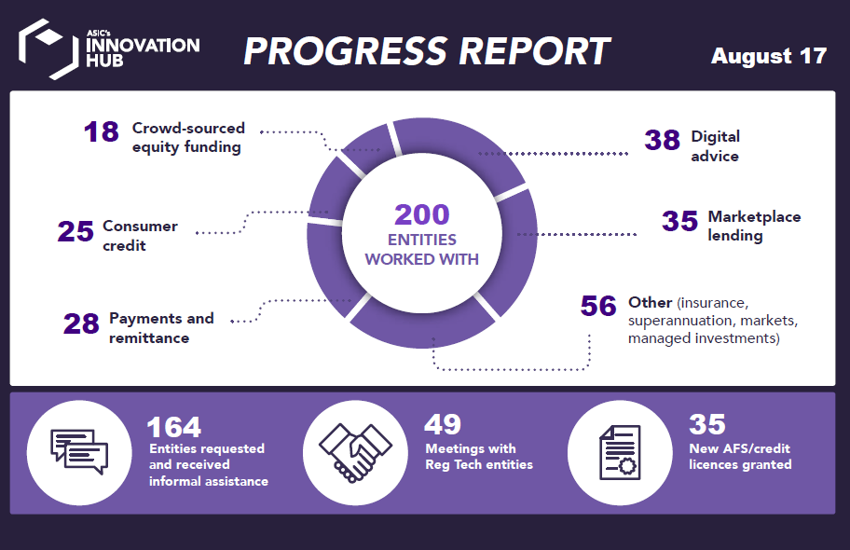

Slide 8
ASIC’s Regulatory Sandbox framework
Context – existing flexible licensing framework.
The regulatory sandbox framework:
Additional guidance – organisational competence
Small-scale, heavily automated business – alternative organisational competence (RG 105)
Limited licensing exemption – the ‘regulatory sandbox’ exemption (RG 257).

Slide 10
Crowd sourced funding
18 CSF entities worked with to date
Consultation period on CP 288 and 289 has concluded.
ASIC will release a feedback statement in the coming weeks and guidance by the end of September for the start of the new regime.

Slide 11
ASIC’s Regtech Showcase – Late September
Session one: The future of regulatory reporting The use of new technologies to provide for more efficient and effective provision and/or access to regulatory information. Session two: Understanding and meeting regulatory obligations How software and algorithms can help firms understand and meet their regulatory obligations more efficiently and effectively .
Register for updates: regtech@asic.gov.au

Slide 12
Further information
Web: | asic.gov.au/for-business/your-business/innovation-hub/
Email: | innovationhub@asic.gov.au

Slide 13
Joint Regulator Info Session
17 August 2017
SYDNEY
Tony Richards
Reserve Bank of Australia

Slide 14
The Reserve Bank’s Roles in the Payments System
Regulator and overseer
Infrastructure provider – RITS operator
Participant – banker to the Government
Banknote issuer

Slide 15
Payments System Board Mandate
Powers under two Acts (PSRA, PSNA) are to be used to
control risk in the financial system
promote efficiency in the payments system
promote competition in the market for payment services
Powers under the Corporations Act are to be used to
contribute to overall stability of the financial system

Slide 16
New Payments Platform Timeline
May 2010: Strategic Review of Innovation announced by Payments System Board
June 2012: RBA Strategic Review Conclusions document released. PSB asked industry to respond
February 2013: PSB welcomed industry proposal for real-time payments
June 2013: New Payments Platform Steering Committee formed to start on design, requirements, vendor selection, build etc
November 2014: 12 (now 13) participants agree to fund NPP Australia. SWIFT announced as infrastructure provider
2016: First drops of SWIFT and RBA FSS functionality; industry testing begins
Late 2017: NPP target go live

Slide 17
Key NPP Functionality
Real-time (notification, funds availability and settlement)
24/7 and high levels of availability
Information rich/ISO20022
Easy addressing (email addresses, phone numbers etc)
Separation of infrastructure and schemes (overlay services)

Slide 18
NPP Program Update
NPPA is staffed and up and running
Central build (SWIFT, FSS) is well advanced
Participants currently in testing phases – major task for them is to prepare their systems for real-time and 24/7 operation
Late 2017 initial go-live and then ramping up
NPPA is stepping up outreach to fintechs, other potential overlay service providers etc (see http://www.nppa.com.au/)

Slide 19
Licensing ADIs
Phased approach to authorising new entrants to the banking industry
August 2017

Slide 20
Licensing statistics
Type of applicant | Number of new entrants over the last 10 years | Number of authorised institutions as at 30 June 2017
Authorised deposit-taking institution | 26 | 149
General insurer | 30 | 104
Life company | 3 | 41
Private health insurer | 6 | 37
RSE Licensee | 12 | 139
Representative office in Australia | 16 | 13
Total number of authorisations | 93 | 483

Slide 21
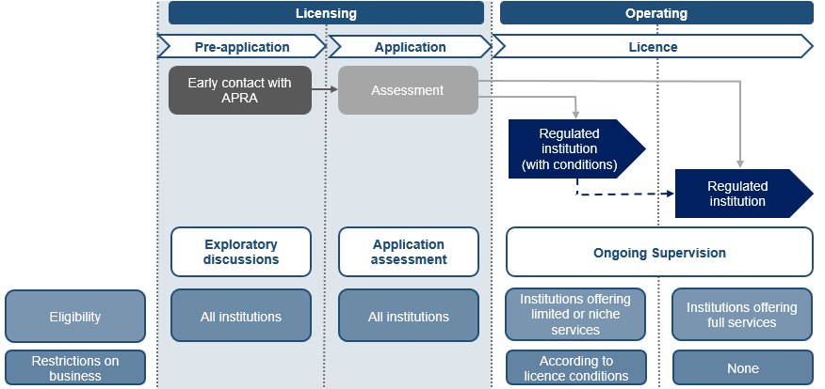
Existing licensing approach

Slide 22
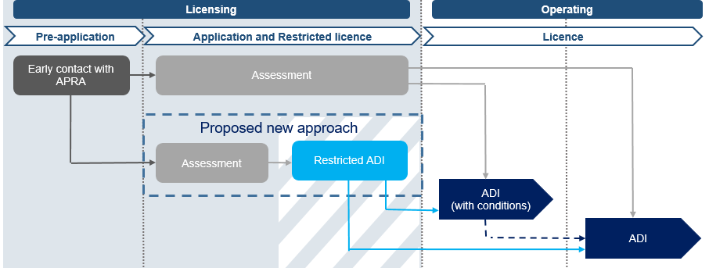
Application broken into two potential phases

Slide 23
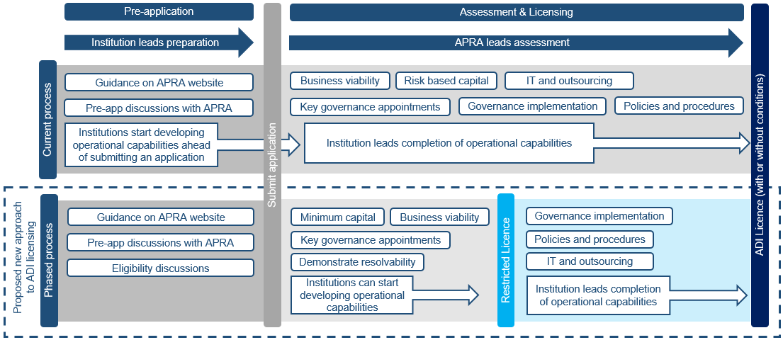
Comparison of licensing process

Slide 24
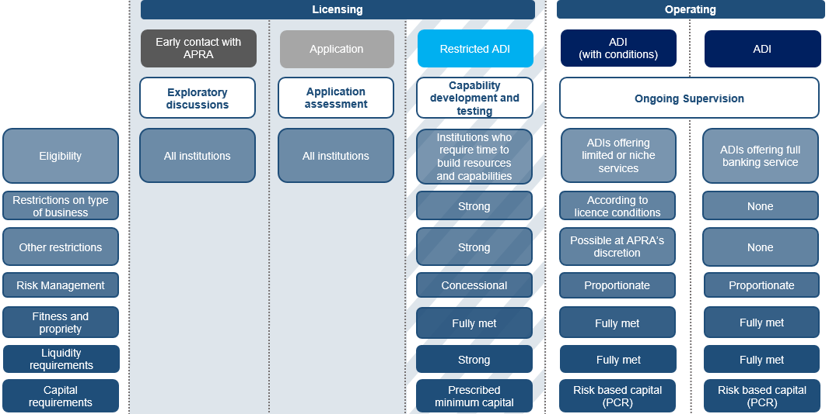
Phased licensing – restricted ADI proposal

Slide 25
Restricted ADI – initial requirements
Business Plan | Credible business plan outlining business model and viability of proposed business.
Strategy to fully meet prudential framework | Credible plans to progress to an ADI licence within the two year restricted licence period.
Governance | Appropriate organisational structure and governance framework. Details of ownership and capacity to support the business.
Capital | Minimum start-up capital of $3m plus wind-up costs.
Fit and Proper | Full compliance with CPS 520 Fit and Proper.
Risk management | Description of risk profile and a strategy for implementing adequate systems and controls prior to conducting any banking business.
Exit Plan | Credible exit plan which demonstrates it is able to protect depositors without reliance on the FCS.
FCS systems and reporting | Ability to provide the necessary information for purposes of the FCS.
Policies and Procedures | Well progressed draft policies and procedures.

Slide 26
Restricted ADI – ongoing requirements
Liabilities | Max aggregate deposits of $2m Individual deposit limit of $250k (FCS amount)
Capital | Minimum capital of $3m plus wind-up costs or 20% of total assets whichever is greater
Liquidity | MLH of 20% of total liabilities
Nature of business | Restricted - focus is on building capabilities and resources and not actively conducting banking business
Disclosure | Clear disclosures on Restricted ADI licence status
Reporting obligations | Specific reporting requirements

Slide 27
A comparison
 | Existing ADI requirement | Existing requirement for operating as a bank | Proposed for Restricted ADI | Comparative UK mobilisation example
Minimum start-up capital requirement | $5 million | $50 million | $3 million (plus wind up costs) | Higher of £1 million or €1 million (plus wind up costs)
Maximum aggregate deposit holdings (FCS eligible) | Nil | Nil | $2 million | £50,000
Maximum individual customer deposit (FCS eligible) | Nil | Nil | $250,000 | Nil
Nature of banking business | No restrictions | No restrictions | Restricted | As per authorisation

Slide 28
Process from here
Mid August | Consultation on discussion paper begins
End November | Consultation period ends
March 2018 | Response paper
Second half 2018 | Updated guidance
Feedback?
Contact us Licensing@apra.gov.au

Slide 29
PUBLIC - PRIVATE PARTNERSHIPS TO COMBAT FINANCIAL CRIME
Sydney: 17 August 2017, Tony Prior, Director - Compliance

Slide 31
AUSTRAC’s RISK
CONTEXT
Tax dodgers
Ice epidemic
Drug money
Digital currencies
Deregulation
Terrorism financing
Panama papers
Privacy
Big data
Al-Qaeda
Disruptive innovation
Fraud
Islamic State
RegTech
Blockchain
Money laundering
Government priorities
Mobile banking
Cyber hacking
Organised crime
Card skimming
Digital transformation
FinTechs
Open data
Budget

Slide 32
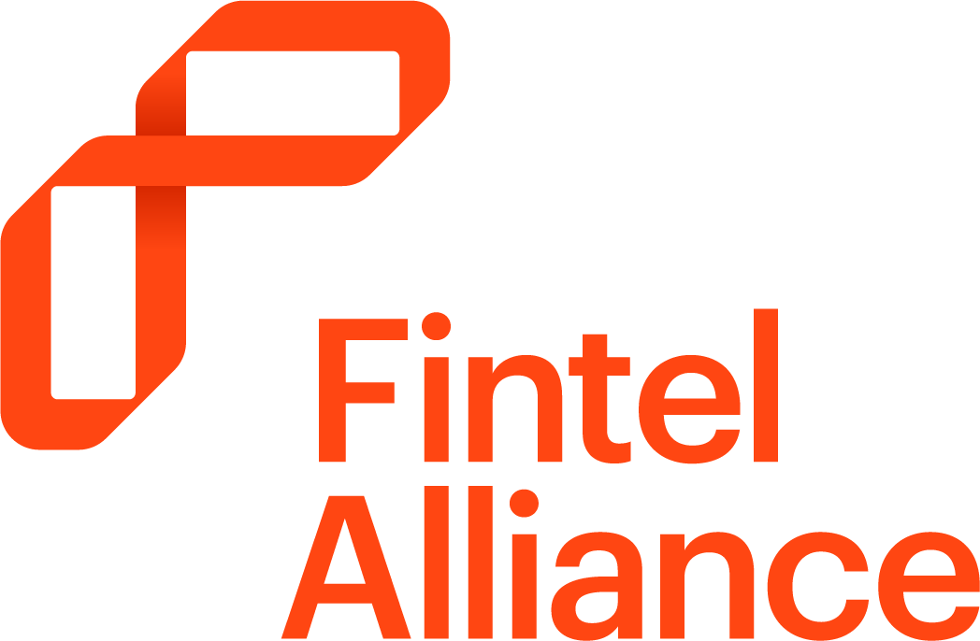
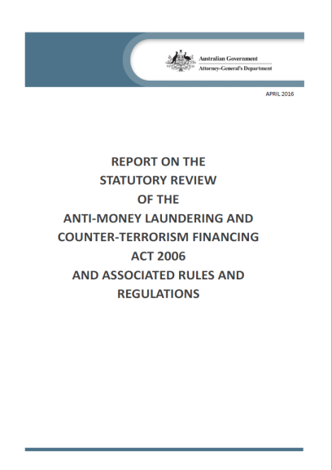
UNDERSTANDING RISK
THROUGH COLLABORATION
Legislative reform of the Anti-Money Laundering and Counter Terrorism Financing Act 2006
Industry and government intelligence operations through the Fintel Alliance
Collectively improving our understanding of risk across the financial sector

Slide 33
SMARTER REGULATION
VISION
A financial system resilient to criminal abuse
clarity • certainty • integrity • trust
a regulated community that is collaborative, knowledgeable, vigilant, engaged and capable of preventing, detecting and responding to threats of criminal abuse and exploitation

Slide 34
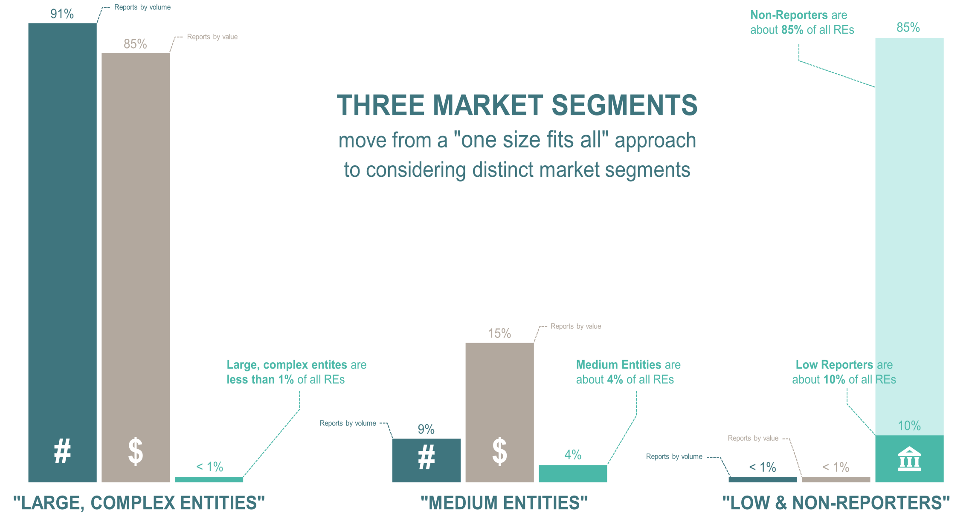
SEGMENTATION

Slide 35
Overview of Risk Model

Slide 37
Brett Watson
OAIC

Slide 38
Overview
Privacy – why you should care
How to do a Privacy Impact Assessment

Slide 39
Why privacy?
Is my business regulated?
Good data handling practice drives commercial success
Build consumer trust
Avoid reputational damage and added costs

Slide 40
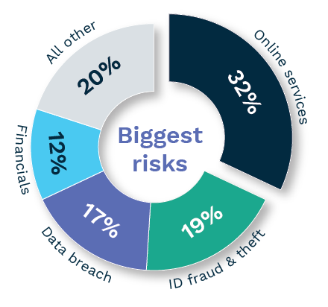
What the community thinks
People believe online services are the greatest privacy risk to the community
When people have privacy concerns, this means…

Slide 41
Privacy Impact Assessments
Map the information flow
Notes:
Privacy Impact Assessments
A PIA is a systematic assessment of a project that identifies the impact that the project might have on the privacy of individuals, and sets out recommendations for managing, minimising or eliminating those impacts. Completing a PIA can be straightforward – the important thing while you are doing it is to turn your mind to the privacy risks.
Each PIA will vary depending on the nature and extent of personal information that is involved in a project, but one of the main things that a PIA should do is map out the information flow for a particular project.
[Show 1st diagram slide]
This is a very basic example of what an information flow in a PIA can look like. In this example, a start-up operator is collecting personal information from an individual, who interacts with the start-up via an app on their smartphone. Once collected, the personal information is transferred to the start-up operator’s IT environment, where the personal information is used to deliver services to the individual. A copy of the individual’s personal information is copied and transferred to a data warehouse for storage.
[Show 2nd diagram slide]
Using this example, mapping out the information flow should provoke questions about how personal information is handled at every step of that information flow. You should be asking yourself questions like:
What types of personal information am I collecting?
How do I intend to use the personal information I collect? Can I use it that way?
How am I notifying the individual about the personal information I am collecting and using?
How will I keep the personal information secure?
[Show 3rd diagram slide]
Using the information flow map, a PIA should then identify any privacy issues and suggest ways that the privacy risks can be managed, minimised or eliminated.
As I have said, this is a very basic example and is by no means exhaustive of the sorts of questions that you should be asking when you conduct a PIA. Having said that, while the information flows may well be far more complex for your start-up, the underlying principles of understanding the flows of information and mitigating any risks that may apply to those information flows are relevant for businesses of all sizes.
There are some other underlying principles that consistently apply to PIAs that are useful to keep in mind:
a PIA should be done at a stage that is early enough for it to influence how the project proceeds (e.g. at the planning and design or business case stage)
a PIA should evolve with a project and be treated as a ‘living document’. Effective PIAs will contemplate privacy risks that might arise if a project expands in scale or scope. When the project changes, the PIA should be revisited and updated
a PIA should incorporate feedback on privacy risks from stakeholders that might be interested or affected by a project.
This has been a brief overview of the PIA process. There is more detailed guidance about conducting PIAs, and about some of the other compliance issues I have mentioned today, in our written privacy resource for start-up businesses. The resource is available on our website, and we have some printouts here for you to take away if you are interested.
Enforcement powers
So while your start-up may or may not need to comply with the Privacy Act, it makes good commercial sense to exercise good privacy practices right from the beginning.
While we encourage businesses to demonstrate good privacy practices, if things do go wrong, the Commissioner has various regulatory powers to ensure compliance with the Privacy Act. This includes seeking a civil penalty of up to $1.7 million for serious or repeated breaches. We will also generally make public any regulatory action we have taken.

Slide 42
Privacy Impact Assessments
Analyse the privacy risks
How will I keep the personal information secure?
Access controls
Data encryption
Audits of data access
Two factor authentication
What types of personal information am I collecting?
Name, age, address, date of birth, credit card details, email address
How am I notifying the individual about the personal information I am collecting and using?
Pop-up alert before app download
Push notifications when personal information is collected
How do I intend to use the personal information I collect?
To deliver media content to the individual
To run analytics on the individual’s usage of the app
Notes:
[Show 3rd diagram slide]
Using the information flow map, a PIA should then identify any privacy issues and suggest ways that the privacy risks can be managed, minimised or eliminated.
As I have said, this is a very basic example and is by no means exhaustive of the sorts of questions that you should be asking when you conduct a PIA. Having said that, while the information flows may well be far more complex for your start-up, the underlying principles of understanding the flows of information and mitigating any risks that may apply to those information flows are relevant for businesses of all sizes.
There are some other underlying principles that consistently apply to PIAs that are useful to keep in mind:
a PIA should be done at a stage that is early enough for it to influence how the project proceeds (e.g. at the planning and design or business case stage)
a PIA should evolve with a project and be treated as a ‘living document’. Effective PIAs will contemplate privacy risks that might arise if a project expands in scale or scope. When the project changes, the PIA should be revisited and updated
a PIA should incorporate feedback on privacy risks from stakeholders that might be interested or affected by a project.
This has been a brief overview of the PIA process. There is more detailed guidance about conducting PIAs, and about some of the other compliance issues I have mentioned today, in our written privacy resource for start-up businesses. The resource is available on our website, and we have some printouts here for you to take away if you are interested.
Enforcement powers
So while your start-up may or may not need to comply with the Privacy Act, it makes good commercial sense to exercise good privacy practices right from the beginning.
While we encourage businesses to demonstrate good privacy practices, if things do go wrong, the Commissioner has various regulatory powers to ensure compliance with the Privacy Act. This includes seeking a civil penalty of up to $1.7 million for serious or repeated breaches. We will also generally make public any regulatory action we have taken.

Slide 43
PIA e-learning module
www.oaic.gov.au/elearning/pia

